Slide 1


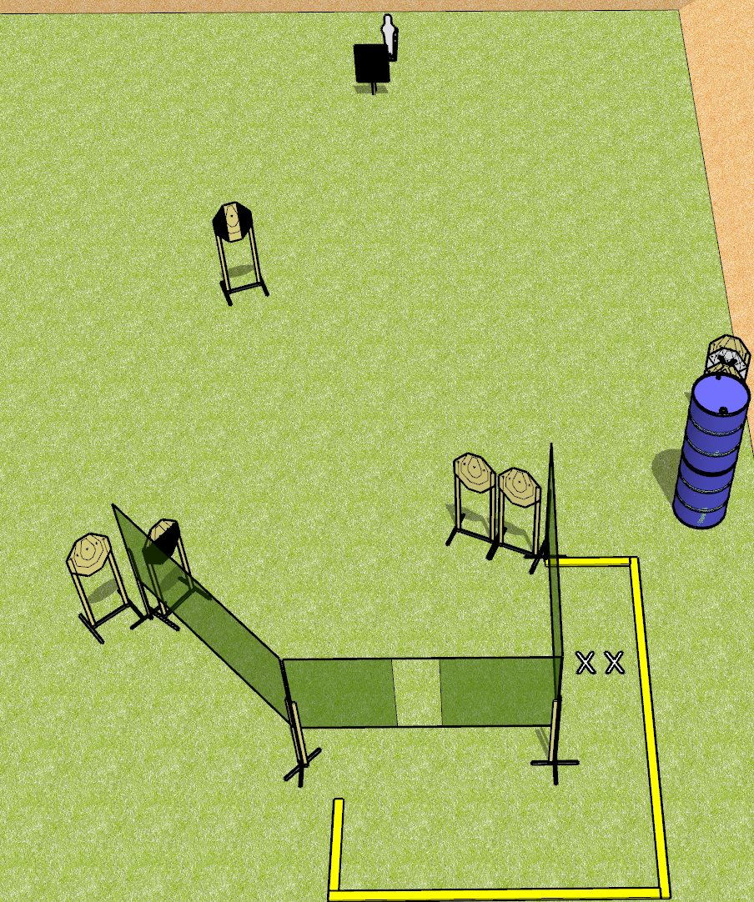
 | Dothan Gun Club – USPSA Match Move Around Course Designer : Drew Coleman
Round Count 15 rounds 7 IPSC targets 1 Mini popper
Equipment List 5 wall feet 2 3 foot fault lines 1 18x24 plate and stand 1 2/3 hard cover, 1 tuxedo Notes: Use plate to cover half of popper from the port. Far right target near barrels is stacked with NS

Slide 2
Move Around
Written Stage Briefing
Move Around is a 15 round, 75 point, Comstock course of fire. There are 7 IPSC targets and 1 mini poppers. The best 2 hits on paper will score, and steel must fall to score. The start signal is audible.
Handgun start position is both feet on X’s, wrists below belt. Handguns is loaded and holstered.
PCC start position is both feet on X’s. Loaded carbine is held with both hands, stock on belt, safety on.
On start signal, engage targets as they become available from within the shooting area.

